Slide 1
Thank you for joining our webinar.
This webinar will begin shortly. The webinar will be recorded. During the presentation your mic will be switched off. If you have any questions or technical issues please use the CHAT box.

Slide 2
An introduction to the Young Professional Membership
Available to every 14-24 year old in the UK, regardless of levels of education or experience
Co-created by young people for young people - informed by extensive research
Builds the skills and confidence young people need for education, training and employment
Supports young people to continue and own a journey of self development

Slide 3
The benefits of the Young Professional Membership
Changes the way young people see themselves
A level playing field
Weekly activities and updates to ensure continued skill ownership and development
Community Members are able to support the creation of challenges and content
Guaranteed interviews with some employers
Signposting to support services, information and opportunities

Slide 4
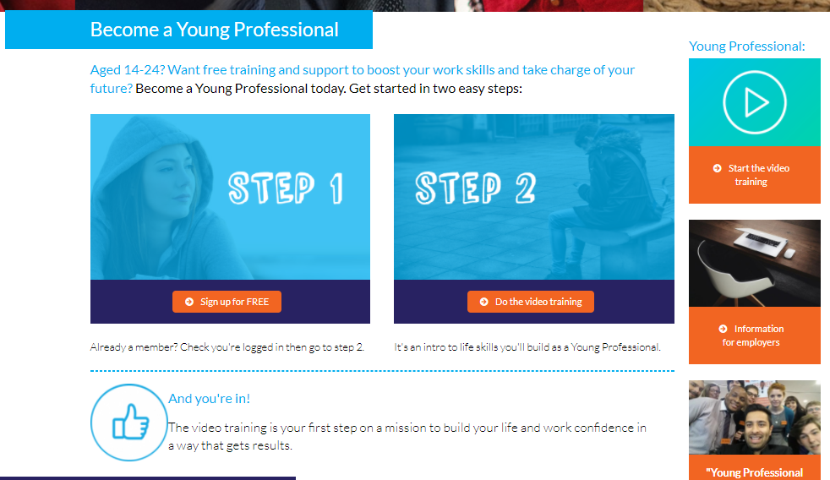
www.youthemployment.org.uk/young-professional-training/

Slide 5
Communication
Self Belief
Problem Solving
Team Work
Self Management

Slide 6
A dedicated Young Professional Hub filled with inspiring content, activities, case studies and much more.
Supporting young people with information and tools to continue their self development.

Slide 7
Next Steps
Embed the Young Professional Membership into your school, college, employability, trainee or apprenticeship programme.
Promote the Young Professional Membership to young people and organisations you are connected to. Our Ambassador Team are able to support with events, presentations and workshops
Offer to guarantee all Young Professionals a job interview
Support the content if you want to work with us on creating challenges for young people to develop their skills get in touch with lauren@yeuk.org.uk

Slide 8
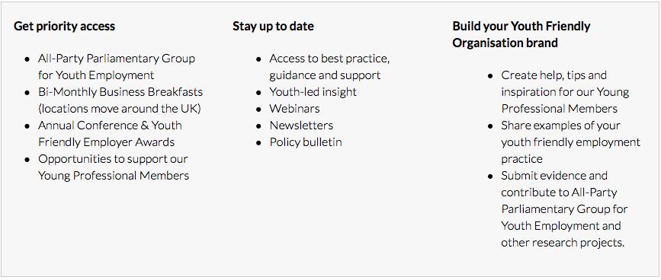
Community Membership
Join a dynamic collective of employers, training providers, educators, youth and third sector organisations. Together we actively represent all stakeholders invested in youth employment.

Slide 9
Contact us for more information:
www.youthemployment.org.uk
info@youthemployment.org.uk

