Slide 1
Recognising Talent
Business Breakfast

Slide 2
Agenda
09.00 - 9.20 - Registration
09.20 - 09.35 - Welcome & Introductions
09.35 - 09.55 - CASCAID
09.55 - 10.30 - About Youth Employment UK
10.30 - 11.10 - Recognising Talent
Vacancy & Attraction Application & Processes Interview & Selection Process
11.10 - 12.00 - Coffee and networking

Slide 3
Career Big Data:
21st Century Careers

Slide 4
About CASCAID
Our mission is to help young people and adults make the best possible decisions about their future career destinations and the learning and training journey that takes them to it

Slide 5
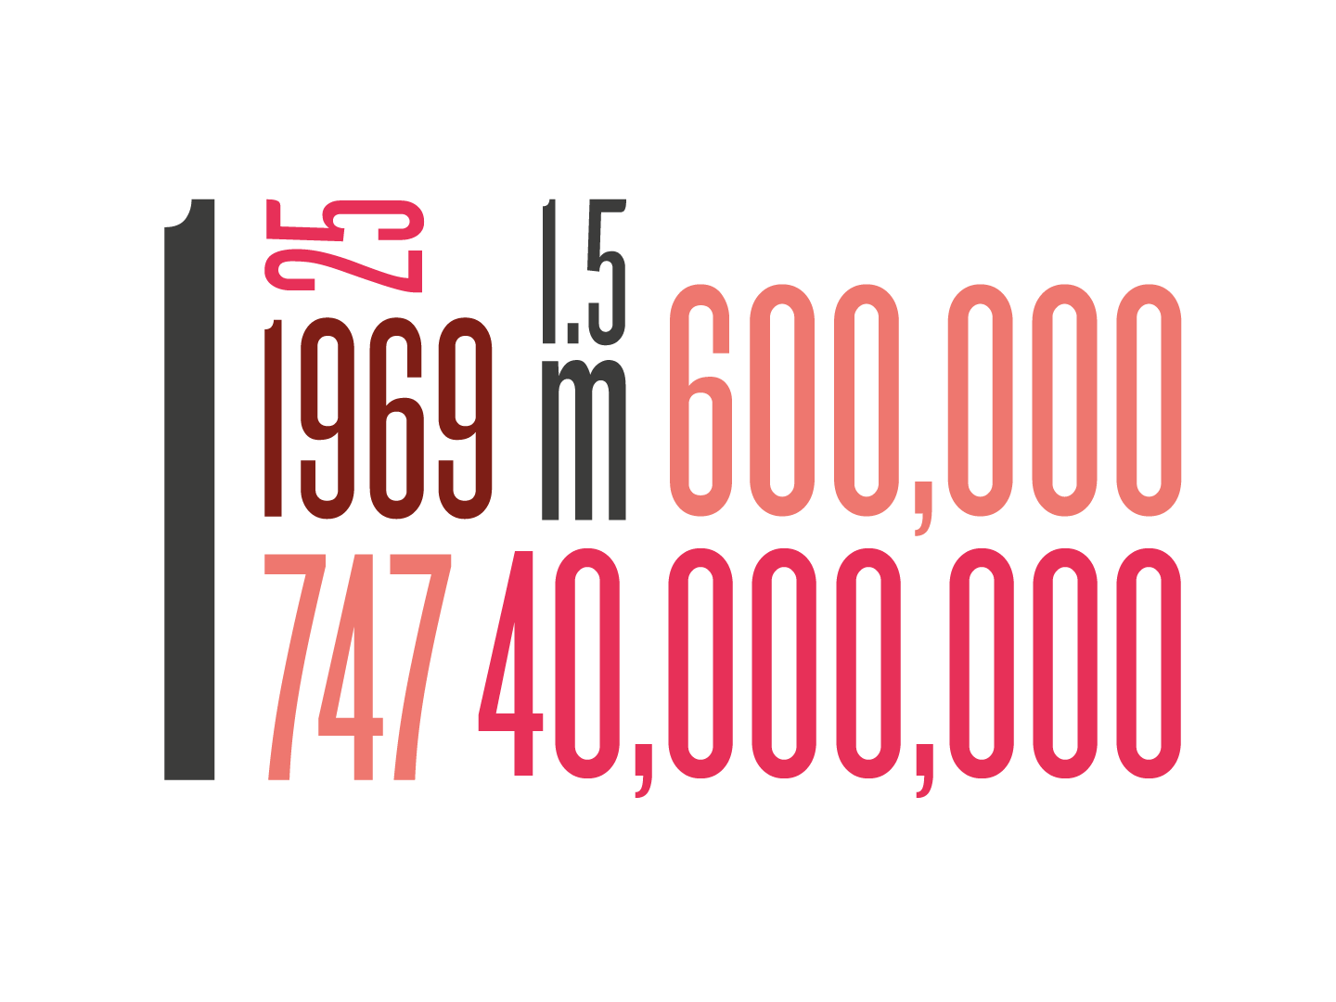
CASCAID in numbers

Slide 6
CONNECTED FROM BIRTH
Born 1990s to 2010

Slide 7
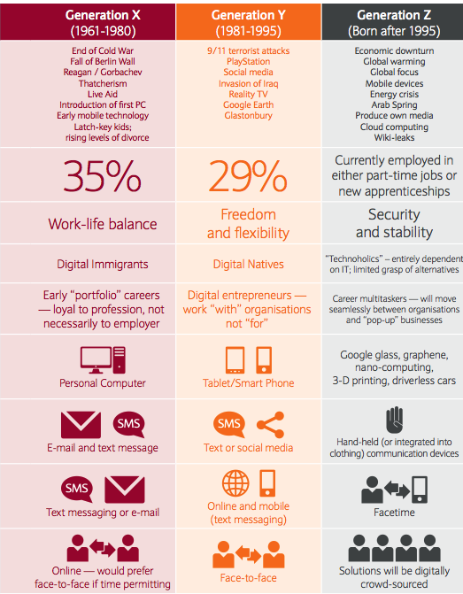
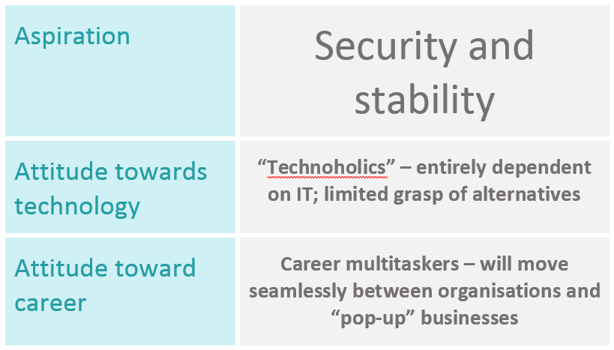
Notes:
http://somethingbig.co.uk/wp-content/uploads/Screen-Shot-2014-07-14-at-17.07.26.png

Slide 8
Notes:
A look at the Kudos journey

Slide 9
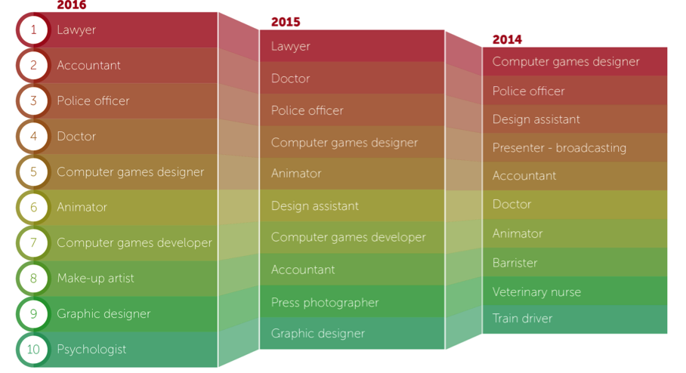
Careers young people are interested in (favourited)

Slide 10
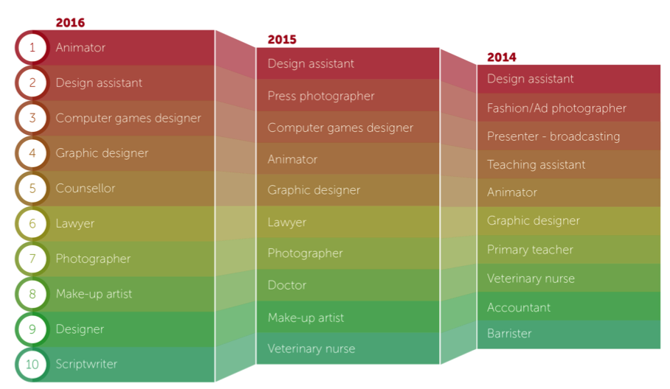
Careers young people are exploring the most (viewed the most)

Slide 11
Feelings skills responses
Stongest
Weakest

Slide 12
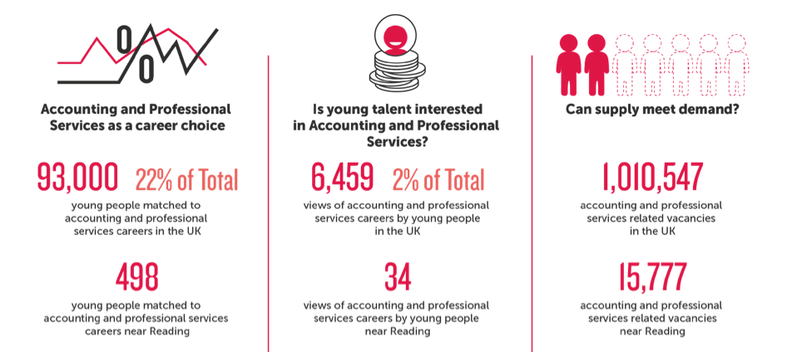
CASCAID data – Market sector

Slide 13
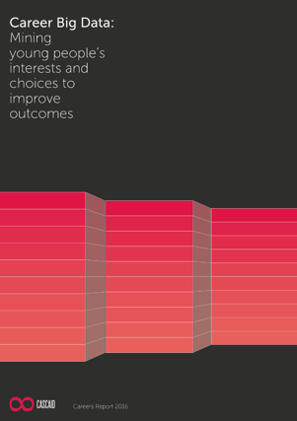
CASCAID data

Slide 14
Q & A
Sharon Walpole, Director
swalpole@cascaid.co.uk
Twitter @SharonWalpole

Slide 16
Youth Employment UK
Our main purpose
To reduce youth unemployment and support every young person to progress.
Our key objectives
To give young people a voice and empower them to be more prepared for the world of work
Employers are better equipped to support young people and adopt Youth Friendly Principles
Government policy is geared towards the real needs of young people

Slide 17
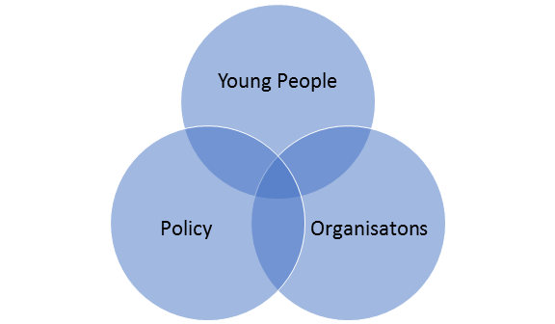
Our model
Youth Voice

Slide 18
What is the Young Professional Membership?
A membership freely available to all young people aged 16-24
Support to develop key skills of - Communication, Teamwork, Problem Solving, Self-Belief and Self-Management
Recognition of a young person's commitment to their personal development
Access to inspiration, peer support, resources and opportunities

Slide 19
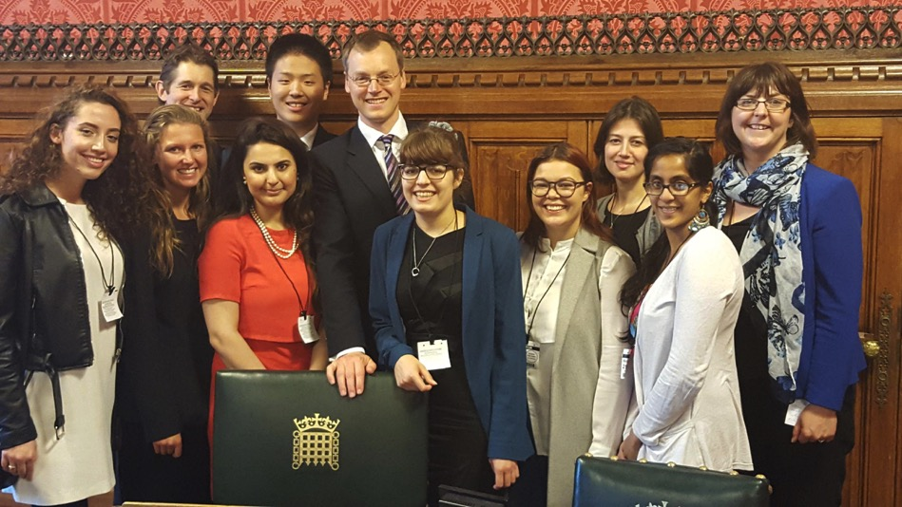
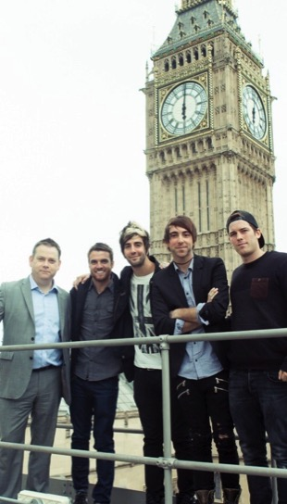
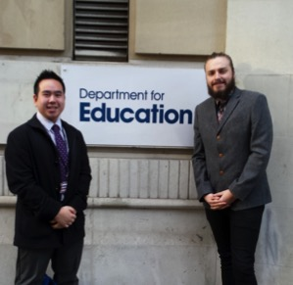
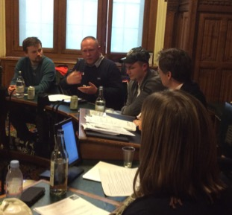
Influencing Policy

Slide 20
The Benefits of our Community Membership
Access to the national Talent Match Mark for Youth Friendly employers
Best practice, case studies and support
Policy insights and influencing opportunities
Connect to other organisations invested in youth employment
Marketing and Promotion
Events and Webinars

Slide 21
Ben Fisher - Youth Ambassador
“What do employers look for when advertising for entry level jobs as every one I have applied for it’s has always been more experience?
Are entry level jobs not about learning and firstly having no experience?
Why can employers not focus on Skills?”
Notes:
Lauren

Slide 22
Recognising Talent
At Youth Employment UK recognising talent is about broadening your recruitment practises to be inclusive of all young people, giving young people from all backgrounds a fair chance.
Recognise:
Grades aren’t everything
There is still development needed
At this stage CV’s and applications need to be supportive

Slide 23
Vacancy and Attraction
Think about your recruit process:
What requirements do you put in place?
Who reviews the vacancies?
Are managers asking for the qualities they have?
How necessary are they?
What restrictions are you putting in place?
How accessible is the vacancy?
How often are adverts reviewed?
“One main thing that I see front facing is how hard it can be to get a job with little to no experience, but then you need a job to get experience!”
Courtney - Youth Ambassador

Slide 24
Vacancy and Attraction
What does best practice look like?

Slide 25
Application Process
Think about your application process:
What requirements do you put in place?
Has the process been reviewed by young people?
How much support is given to applicants so that all young people can access the opportunity?
What shortlisting criteria do you have in place?
Do you provide feedback, at what stage?
“I feel there is way too much misunderstanding of young people’s capabilities. Why can an employer not look to a young person with a business qualification or recent experience/business skills?”
Ben - Youth Ambassador

Slide 26
Application Process
What does best practice look like?

Slide 27
Interview & Selection Process
How accessible and what provisions are put in place at assessment centres?
Doing things how they have always been done: using the same interview process for every role
Consider alternatives: Skills based interviews
Giving feedback
I also feel not all companies give constructive enough feedback which is very important especially for young/first time workers”
Courtney - Youth Ambassador

Slide 28
Talent Match Mark - championing youth friendly employers
Bronze, Silver, Gold and Platinum Awards
Recognition as a youth friendly employer
Support and information
Full framework to help develop policies and procedures

Slide 29
www.yeuk.org.uk
ljr@yeuk.org.uk
@ljrawlings

