Slide 2
Graham Moore

Slide 3
Who Are We?

Slide 4
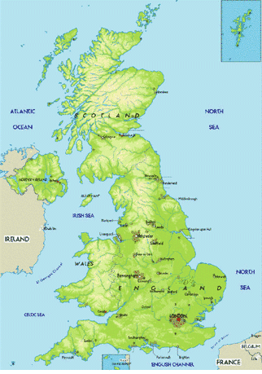
Between 2004-2017…. humanutopia has influenced
200 schools
200,000 young people 25,000 adults in over 30 different UK cities and towns

Slide 5
What do we do ?

Slide 6
We create and run, high impact, life-changing courses for students and adults in schools and their wider communities.

Slide 8
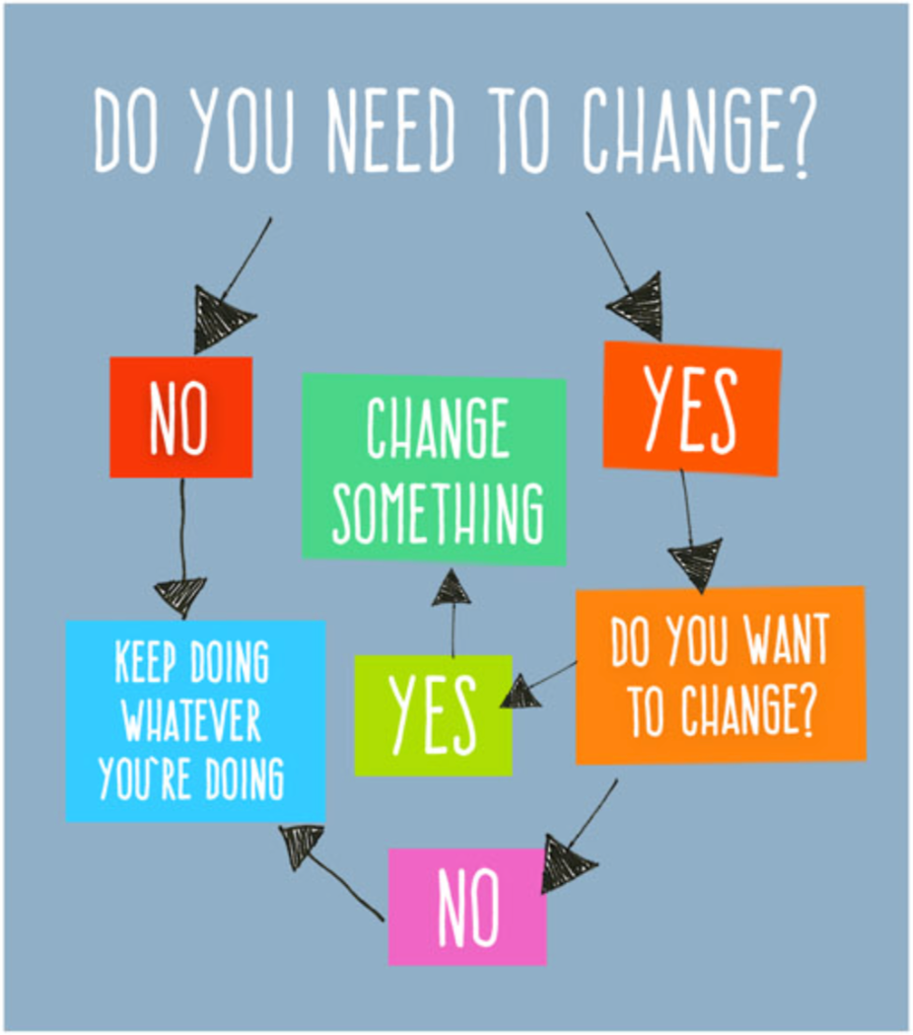

Slide 9
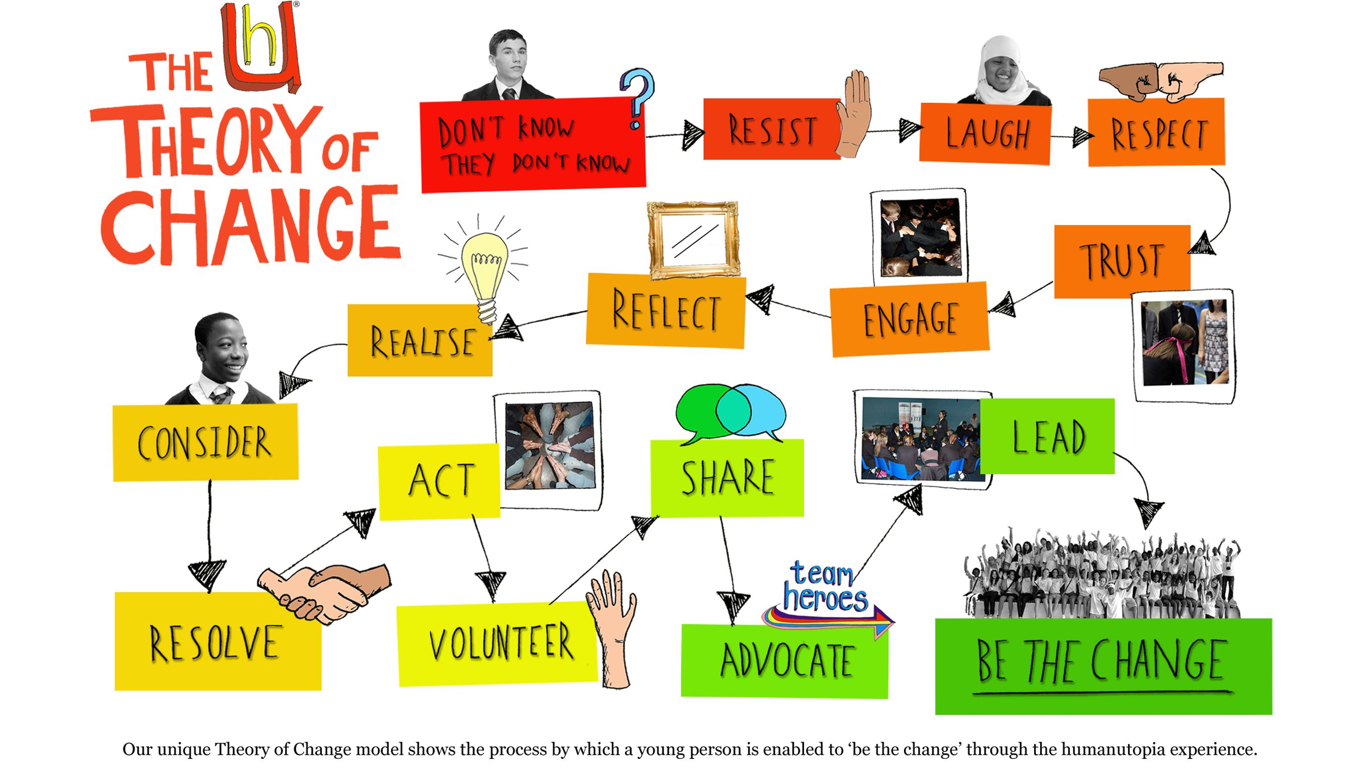
4

Slide 10
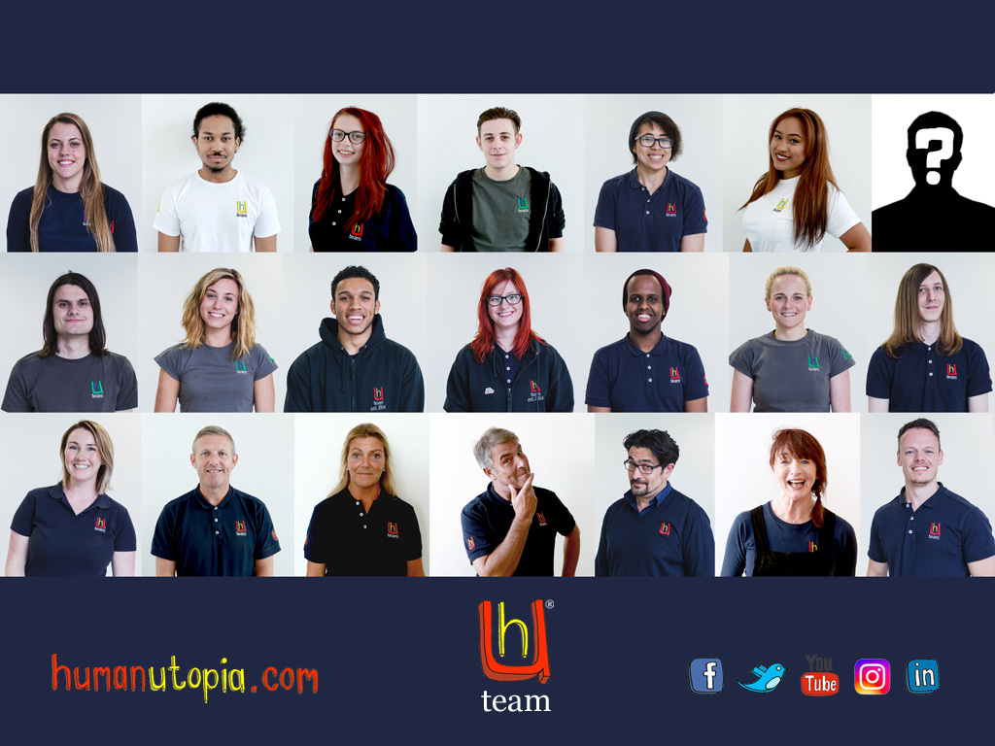

Slide 11
Small Employer of the year
2015
2016

Slide 12
Youth Board
Anyone aged 16-24

Slide 13
Youth Board Activities
Heroes Summit
Recruitment
Programme development
Social Media
Apprentice development

Slide 14
Heroes summit movie

