Slide 1
Business Breakfast
Youth Voice

Slide 2
Welcome
Laura-Jane Rawlings
CEO Youth Employment UK

Slide 3
Agenda
About Youth Employment UK
Youth Friendly Employment Framework
Humanutopia
Costain
Talent Match Black Country
Close

Slide 4
About Youth Employment UK
Our main purpose:
To reduce youth unemployment and support every young person to progress.
Our key objectives:
Young People are more prepared for the world of work
Government policy is geared towards the real needs of young people
Employers are better equipped to support young people and adopt Youth Friendly Charter

Slide 5
Youth Friendly Employment
Youth Voice
Creating Opportunity
Recognising Talent
Fair Employment
Developing People

Slide 6
Youth Friendly Employment Framework

Slide 7
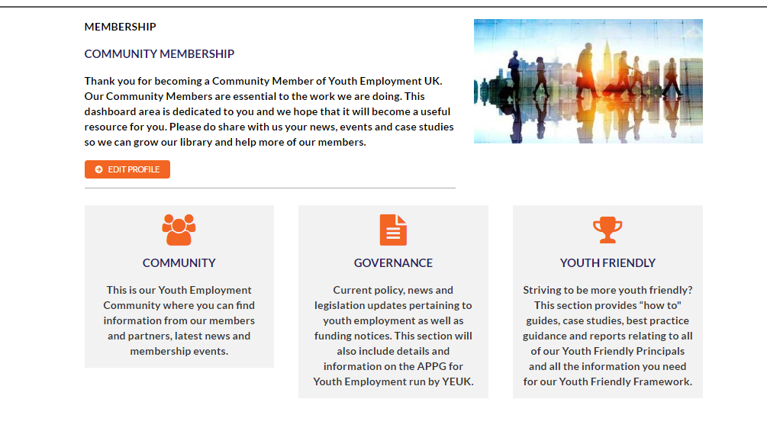
Support for Community Members

Slide 8
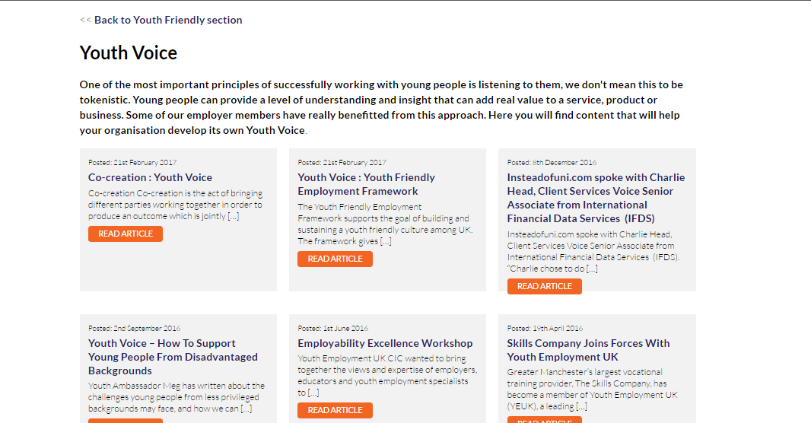
Support for Community Members

Slide 9
A sustainable approach to youth friendly employment
External Evaluation Report
Dr Anna Carlile
Department of Educational Studies, Goldsmiths, University of London
The Youth Friendly Employment Framework has been constructed to establish a sustainable
approach to youth friendly employment practices. Key to this is the requirement for the
development of appropriate policies. Organisational policies have the effect of embedding an
initiative over time, but they need to be underpinned with a clear outline of the roles and
responsibilities attached. The Framework provides for these. Finally, the regular review mechanisms included throughout the Framework ensure that the youth-friendly employment initiative stays current and relevant to the changing needs of the organisation.
The Framework finds the right balance between directing employers towards important considerations in the employment of young people and allowing for the specificities of each employer to benefit from it.

Slide 10
Additional Support
“The Youth friendly framework gives organisations the tools and support they need to ensure their organisation is positioned to maximise the potential of the young people it engages as employees, customers or other stakeholders.”
Iain Salisbury, CEO leardirect
“ The Youth Friendly Employment Framework is an excellent tool that highlights, to employers, the wide spectrum of ways they can support young people both as employees and across the wider community. If every employer implemented just some of these recommendations we would see many of the career barriers young people face disappear.”
Marie Graham
Greater Manchester Talent Match Programme Manager

Slide 11
What next?
A small selection of employers will be able to express an interest in being part of research group
Expressions of interest to be a regional delivery partner are now open
Organisations who wish to support the development of the work are invited to talk to the Youth Employment UK team
Youth Employment UK Community Members can now access the framework and supporting resources

Slide 12
www.yeuk.org.uk
ljr@yeuk.org.uk

