Slide 1
Youth Employment UK
22 February 2017

Slide 2
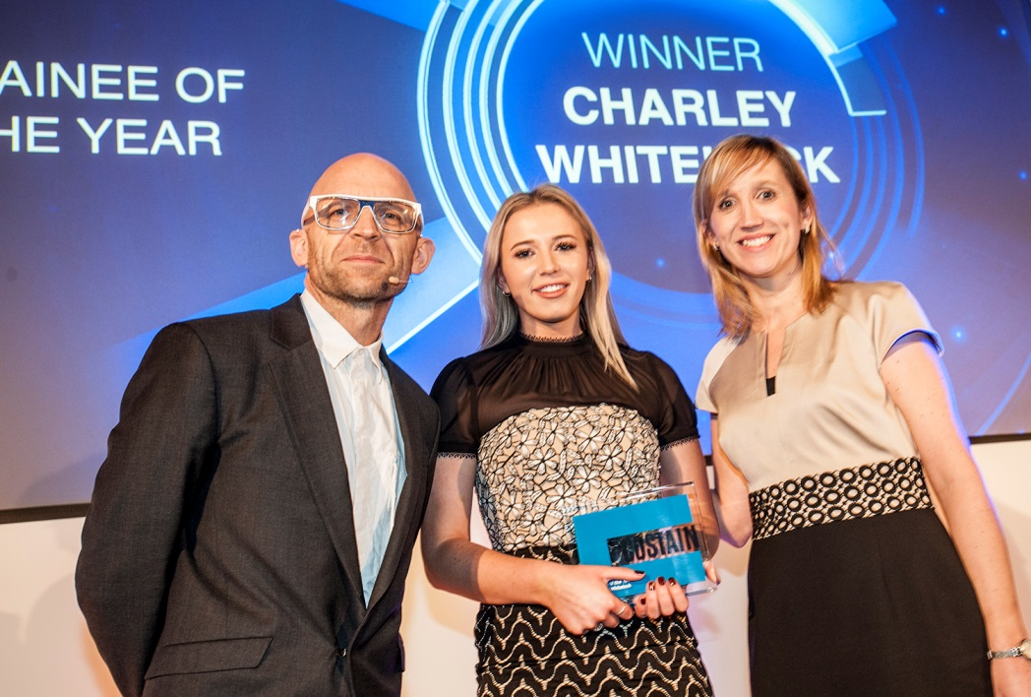
A bit about me…
Previous apprentice
Level 4 Higher Apprenticeship in Public Relations
Community Relations and
Communications Officer
Costain JV for the Thames Tideway
Tunnel super sewer construction
2 years and 4 months with Costain
21 years of age

Slide 3
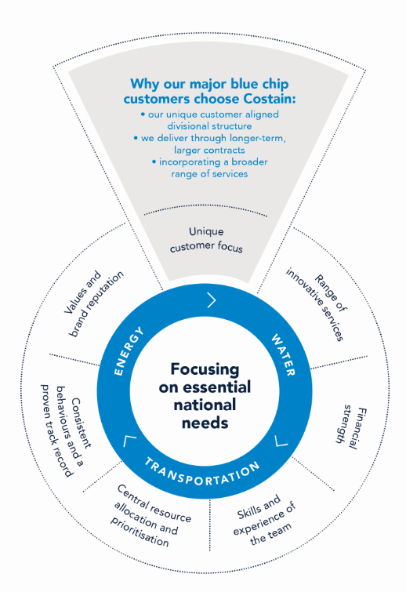














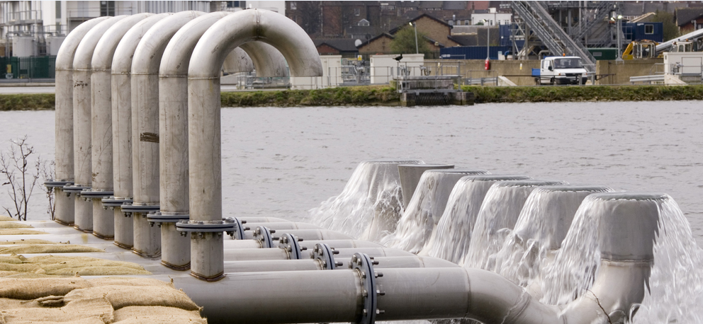













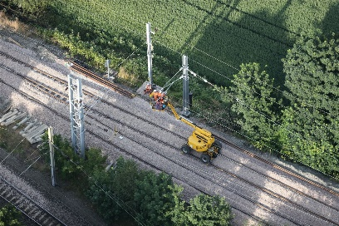







Who are Costain?
Infrastructure
Securing a future energy supply…
…maintaining a safe and reliable water supply
Natural Resources
…upgrading the transport infrastructure
Notes:
We work with a select group of around 40 customers all based in the UK. Provide the solutions to the ensure that everyone in the UK has clean reliable drinking water, power whenever it is needed and a reliable transport network.
We focus on essential needs; energy, transportation (highway and railway) and water.
Some of the reasons we feel our customers choose us for an unique customer focus, values, brand and reputation, innovations and our skilled team members.

Slide 4
Costain values
Ensuring Costain is a safe and great place to work
Creating a better environment
Supporting our local communities and leaving a positive legacy
Providing better solutions for the market place
Notes:
Costain is one of the UK's leading engineering solutions providers, operating in energy, water and transportation

Slide 5

Opportunities
Apprenticeships
From Accountancy to Track and Signalling Engineering, Public Relations and Business Administration – level 2 GCSE to level 6 & 7 Degrees
Graduate programme
11 diverse disciplines, from Civil Engineering, Quantity Surveying and Mechanical Engineering through to Bid Authoring and Finance. Broadening this further to encompass technology disciplines such as computer and data science.
Work experience
14-18 years looking to gain experience in an engineering and construction environment.
Sponsorships and internships
We provide sponsorship and work placements to students in any year of study.

Slide 6

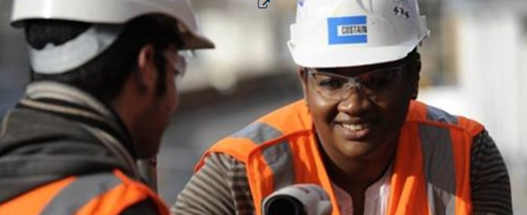
Young employees having a voice
Apprenticeship and graduate forums
Assigned business improvement projects
Line managers, mentors and buddy systems
SMART objectives
Case study tools
Job exploration and flexibility
Site visits and lessons learnt
Core team
Notes:
Forums – lead by apprentices and graduates fed-back to management with support of growth.
Business case style which will require a step by step skill development and even presenting to the top.
Line managers and mentors – direct point of contact and mentor - ensure young people have someone who can guide them through their journey. Someone who will challenge them but also champion their input
Case studies for business review and promotion
Job exploration and flexibility
Site visits and lessons learnt – your opinion encouraged for improvement
Core team – coordinates the recruitment of young people and supports their personal development.

Slide 7
Closing message
Costain will provide the environment, it is down to the individual to make the most of the opportunity.
The support is there for anyone who wants it.

Slide 8

Questions

